Slide 1

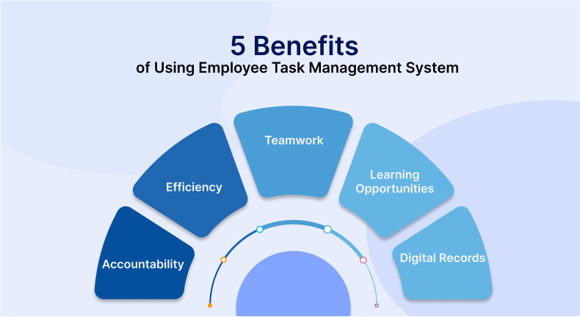
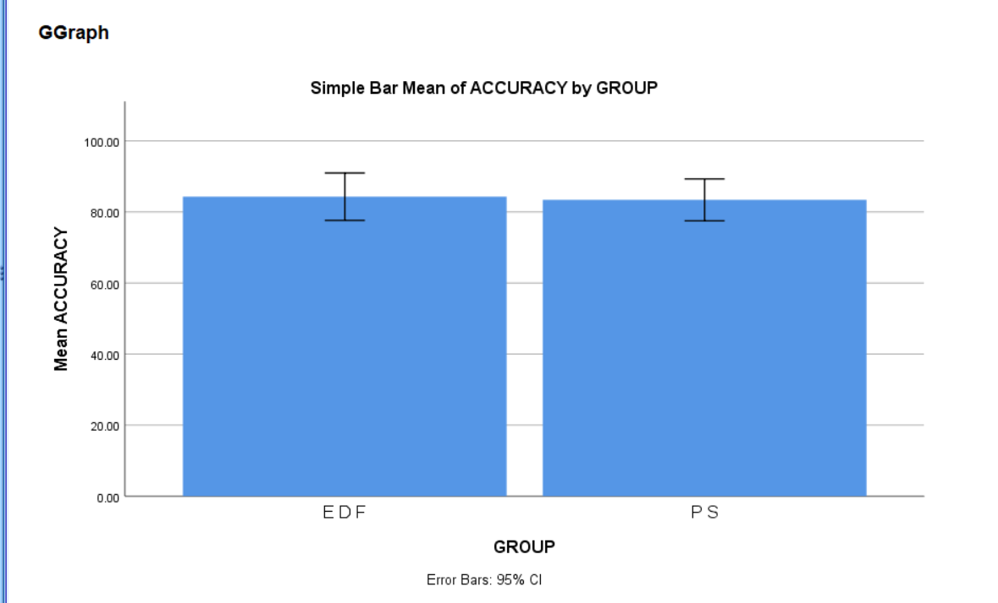
Name: Mr. V.VAMSI Register Number: 192212079
Guided by Dr. R. DINESH KUMAR
Ms. Poorani.S
Guided by Dr. Mary Valantina. G
Short time task management system for increasing productivity by using priority scheduling Comparing with Earliest deadline First.
INTRODUCTION
The current scheduling method in your task management system. This could be priority scheduling, round-robin scheduling, or any other method used to allocate resources.
Define EDF scheduling as a method that prioritizes tasks based on their deadlines, where tasks with the earliest deadlines are given precedence.Highlight the benefits of EDF scheduling, such as ensuring timely completion of tasks and minimizing deadline violations.
Provide a clear rationale for transitioning to EDF scheduling. Emphasize how EDF can improve task management by focusing on meeting deadlines, which is crucial for maintaining productivity and meeting client or stakeholder expectations.
Explain the key features and principles of EDF scheduling, such as dynamically adjusting task priorities based on their deadlines and the concept of preemptive scheduling.
Communicate the upcoming changes to all stakeholders involved, including developers, system administrators, and end-users. Clearly explain the benefits of EDF scheduling and how it will impact their workflow.
Provide training or documentation on how EDF scheduling works and how stakeholders can adapt to the changes.
Conduct thorough testing of the EDF scheduling implementation to ensure its functionality, reliability, and performance.Gather feedback from testers and stakeholders and make any necessary adjustments before deploying EDF scheduling in a production environment.
MATERIALS AND METHODS
Tasks prioritization
Executed all the tasks
Initialization of Tasks
Execution
scheduling
Result
RESULTS
 | Algorithm | N | Mean | Std.Deviation | Std.Error Mean
Accuracy | Priority Scheduling | 10 | 83.4000 | 8.24891 | 2.60853
 | Earliest deadline first | 10 | 84.3000 | 9.33393 | 2.95165
In the present work, priority scheduling (PS) is compared with Earliest deadline first (EDF) and it depicts that the proposed algorithm gives more accuracy when compared with the priority scheduling. Earliest deadline first outperforms in priority scheduling in task management system by better handling binary outcome prediction and proving more accurate classification
DISCUSSION AND CONCLUSION
Based on T-test Statistical analysis, the significance value of p=0.001 (independent sample T - test p<0.05) is obtained and shows that there is a statistical significant difference between the group 1 and group 2.
Overall , the accuracy of the priority scheduling (PS) is 50.00 % and it is better than the other algorithm.
Earliest deadline first (EDF) - 35.12%
First come first sreve (FCFS) - 45.00%
Priority Scheduling (PS) - 50.00%
deadline scheduling (DS) - 33.33%
Round Robin scheduling(RRS) - 30.22%
The key features and principles of EDF scheduling, such as dynamically adjusting task priorities and preemptive scheduling, offer a robust framework for effective task prioritization in diverse contexts.
The transition to EDF scheduling is deployed and evaluated, ongoing monitoring and optimization efforts will be vital to fine-tune performance and address any unforeseen challenges.
Stakeholder buy-in and understanding of the rationale behind the transition have played a crucial role in facilitating acceptance and adoption.
BIBLIOGRAPHY
Nass, S. J., Levit, L. A., Gostin, L. O., et al. (2009). The value, importance, and oversight of health research.Thiese MS. Observational and interventional study design types; an overview. Biochemia medica: Biochemia medica. 2014;24(2):199–210.
Ioannidis JP, Greenland S, Hlatky MA, Khoury MJ, Macleod MR, Moher D, Schulz KF, Tibshirani R. Increasing value and reducing waste in research design, conduct, and analysis. Lancet. 2014;383(9912):166–75.
Brandizi M, Melnichuk O, Bild R, Kohlmayer F, Rodriguez-Castro B, Spengler H, Kuhn KA, Kuchinke W, Ohmann C, Mustonen T, et al. Orchestrating differential data access for translational research: a pilot implementation. BMC Med Inform Decis Mak. 2017;17(1):30.
Coorevits P, Sundgren M, Klein GO, Bahr A, Claerhout B, Daniel C, Dugas M, Dupont D, Schmidt A, Singleton P, et al. Electronic health records: new opportunities for clinical research. J Intern Med. 2013;274(6):547–60.
Holl S, Zimmermann O, Palmblad M, Mohammed Y, Hofmann M. A new optimization phase for scientific workflow management systems. Futur Gener Comput Syst. 2014;36:352–62.
Liew CS, Atkinson MP, Galea M, Ang TF, Martin P, Hemert JIV. Scientific workflows: moving across paradigms. ACM Computing Surveys (CSUR). 2017;49(4):66.
Wolstencroft K, Haines R, Fellows D, Williams A, Withers D, Owen S, Soiland-Reyes S, Dunlop I, Nenadic A, Fisher P, et al. The taverna workflow suite: designing and executing workflows of web services on the desktop, web or in the cloud. Nucleic Acids Res. 2013;41(W1):W557–61.
Jain A, Ong SP, Chen W, Medasani B, Qu X, Kocher M, Brafman M, Petretto G, Rignanese G-M, Hautier G, et al. Fireworks: A dynamic workflow system designed for high-throughput applications.

